Slide 1
Machine Learning
Muttineni Sai Rohith
Tata Consultancy Services

Slide 2
Outline
Python and Data Analytic Functions in Python
Data Collection and Exploration
Data Preprocessing Techniques
Machine Learning Algorithms
Developing Machine Learning Models
Deep Learning and Hyper parametric tuning
Evaluation Metrics and Results

Slide 3
Machine Learning
Machine learning is an application or subset of AI that allows machines to learn from data without being programmed explicitly
Technically,
A computer program is said to learn from experience (E) with some class of tasks (T) and a performance measure (P) if its performance at tasks in T as measured by P improves with E

Slide 4
Why Machine Learning:
Develop systems that can automatically adapt and customize themselves to individual users. – Personalized news or mail filter
• Discover new knowledge from large databases (data mining). – Market basket analysis.
• Ability to mimic human and replace certain monotonous tasks - which require some intelligence. - like recognizing handwritten characters
• Develop systems that are too difficult/expensive to construct manually because they require specific detailed skills or knowledge tuned to a specific task (knowledge engineering bottleneck)

Slide 5
Why now?
Flood of available data (especially with the advent of the Internet)
Increasing computational power
Growing progress in available algorithms and theory developed by researchers
Increasing support from industries

Slide 6
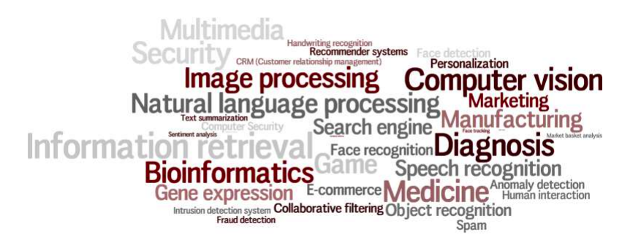
Machine Learning Applications

Slide 7
Learning in ML
Learning = Gaining more knowledge on a situation with experience by performing some tasks
– Improve over task T,
– With respect to performance measure, P
– Based on experience, E

Slide 8
Example: Email Spam Filters
Spam - is all email the user does not want to receive and has not asked to receive
T: Identify Spam Emails
P: % of spam emails that were filtered % of ham/ (non-spam) emails that were incorrectly filtered-out
E: a database of emails that were labelled by users

Slide 9
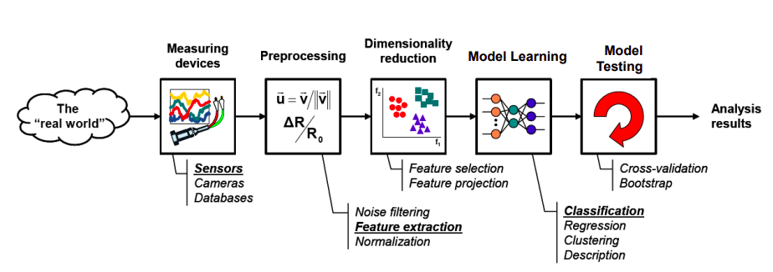
Learning Process:

Slide 10
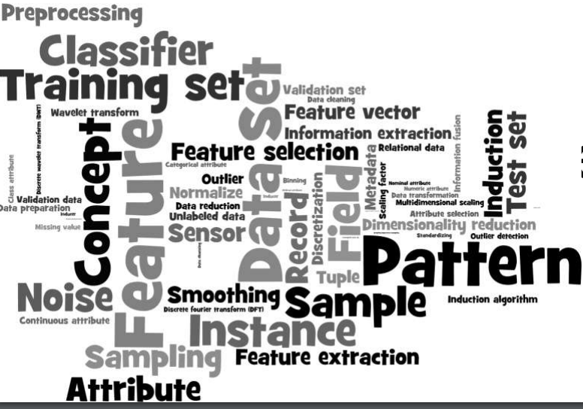
Terminology:

Slide 11
Terminology:
• Samples – A sample is an item to process (e.g. classify). It can be a document, a picture, a sound, a video, a row in database or CSV file, or whatever you can describe with a fixed set of quantitative traits.
• Feature extraction – Preparation of feature vector – transforms the data in the high-dimensional space to a space of fewer dimensions.
• Features – The number of features or distinct traits that can be used to describe each item in a quantitative manner.
• Training/Evolution set – Set of data to discover potentially predictive relationships.

Slide 12
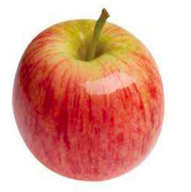
Features:
Color : Red/reddish
Type: fruit
Shape, structure etc.,

Slide 13
Categories:
• Supervised Learning
• Unsupervised Learning
• Semi-Supervised Learning
• Reinforcement Learning

Slide 14
Supervised Learning:
Along with the data, we give feedback.
That means machine learning algorithm is trained on labeled data.
Even though the data needs to be labeled accurately for this method to work, supervised learning is extremely powerful when used in the right circumstances.

Slide 15
Unsupervised Learning:
No feedback about the data is given to Algorithm.
That means algorithm has to work with unlabelled data.
It has to Identify patterns or anomalies in data in an abstract manner.

Slide 16
Example:
Identifying the gender of participants in this call
Supervised:
Data Label
Manish male
Swetha female
Unsupervised: Only names

Slide 17
Reinforcement learning:
It works like how human beings learn from data in their lives.
It features an algorithm that improves upon itself and learns from new situations using a trial-and-error method.
Favorable outputs are encouraged or ‘reinforced’, and non-favorable outputs are discouraged or ‘punished’

Slide 18
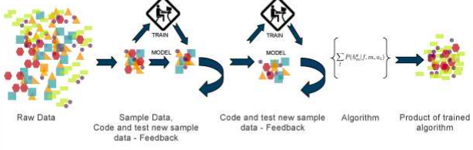
Reinforcement Learning

Slide 19
Example:
When u are walking in a room with eyes closed:
--- When u hit a wall, u will take is an punishment(reward = -2)
--- when u take a step ahead, without obstacle(reward = 2)
--- when u reach the door(reward = 4)

Slide 20
Few techniques in ML:
Classification : Predicting classes from observations.
Regression : Predicting values from observations.
Clustering : Group observations into “meaningful” groups.

Slide 21

Classification:

Slide 22
Classification:
Classification is the type of Supervised Learning in which labelled data can use, and this data is used to make predictions in a non-continuous form.
In the classification technique, the algorithm learns from the data input given to it and then uses this learning to classify new observation. This data set may merely be bi-class, or it may be multi-class too
One of the examples of classification problems is to check whether the email is spam or not spam by train the algorithm for different spam words or emails.

Slide 23
Classification Algorithms:
Logistic Regression/Classification
K-Nearest Neighbours
Support Vector Machines
Decision Tree Classification
Random Forest

Slide 24
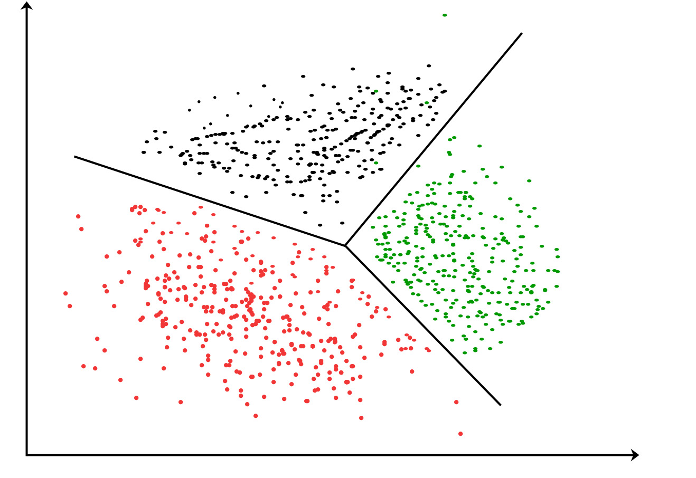
Clustering:

Slide 25
Clustering:
Clustering is the type of Unsupervised Learning in which unlabeled data used, and it is the process of grouping similar entities together, and then the grouped data is used to make clusters
Goal is to find similarities in the data point and group similar data points together and to figures out that new data should belong to which cluster.

Slide 26
Clustering:
K-Means Clustering
Hierarchical Clustering
DB Scan Clustering

Slide 27
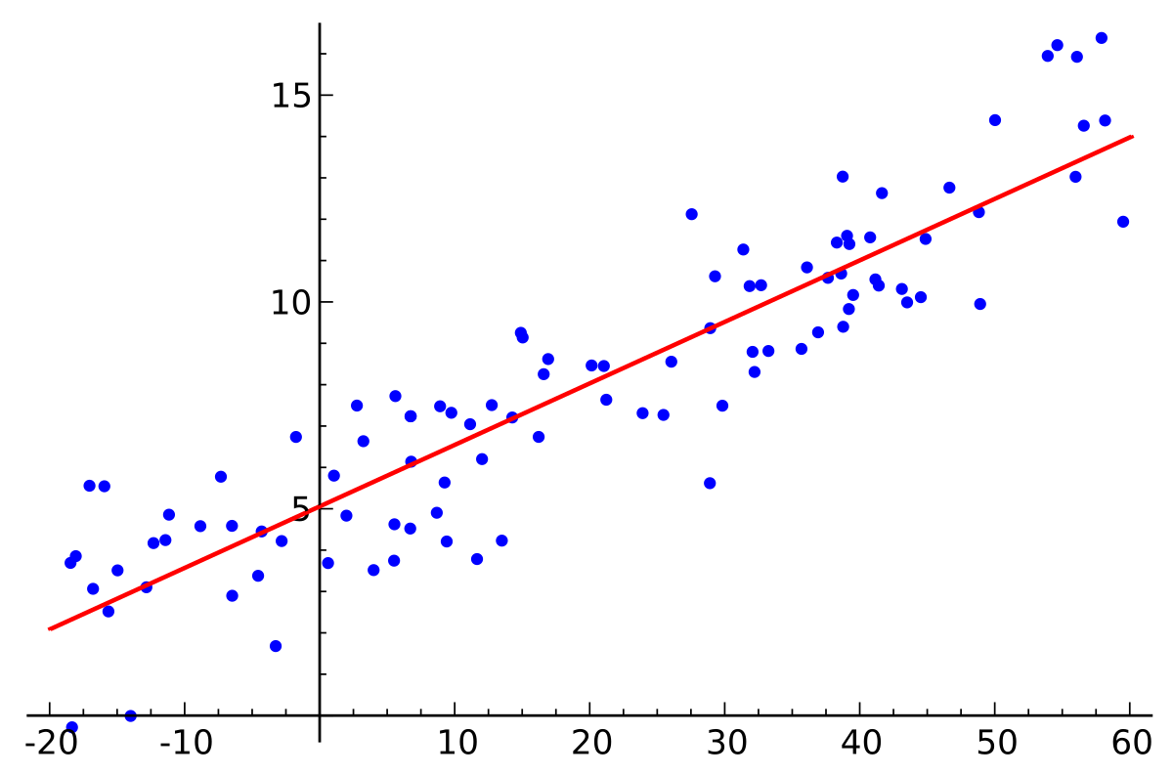
Regression:

Slide 28
Regression:
Regression analysis is a statistical process for estimating the relationships among variables.
It is a measure of the relation between the mean value of one variable (e.g. output) and corresponding values of other variables (e.g. time and cost).

Slide 29
Regression:
Linear Regression
Lasso Regression
Support Vector Regression
Bayesian Regression

Slide 30
Python, Numpy, Pandas, Matplotlib, Seaborne
Data Preprocessing Techniques
Training, Developing, Testing and Validating the model
Step - I
Step - 2
Step - 3
Step - 4
Step - 5
Learning about statistics, Sampling Techniques etcs.,
Machine Learning Algorithms and Feature Extractions

Slide 31
Thank you
Let's start the steps one by one what are we waiting for

